Slide 1

HR Insights at Legacies Group
By: Adetutu Adejuyigbe
Data Analyst

Slide 2
Introduction
Legacies Group, a prominent American media company is marked for the successful acquisition of numerous radio brands. The purpose of this report is to meticulously analyze data sourced from the HR department. Our objective is to provide valuable insights into the intricacies of the company's workforce, shedding light on the comprehensive array of activities that transpire within our esteemed organization.

Slide 3
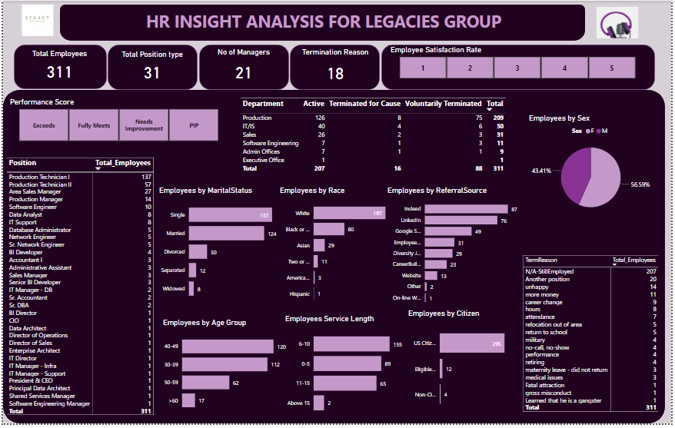

Slide 4
An Overview of Employee Dynamics at Legacies Group
Legacies Group, an American company, has a workforce of 311 employees, including 21 skilled managers. This dedicated team is organized into five distinct departments, with a total of 31 unique positions. Committed to diversity, Legacies Group embodies the American spirit, representing six different races within its organizational structure.
Over the course of this overview, we will delve into further details and categorizations of the employees' status at Legacies Group across various criteria.

Slide 5
Demographic Profile of Employees
Female employees comprise the majority, accounting for approximately 57% of the workforce, while male employees make up the remaining 43%.
Single employees are the most common marital status, with a total of 137 individuals, whereas widowed employees are the least common, with only 8.
The age group with the highest number of employees falls within the 40-49 years range, totaling 120 individuals, while employees above 60 years are the least represented, with a total of 17.
Most employees belong to the "White" racial category, with 187 individuals, followed by "Black American" with 80 employees. The "Hispanic" category has the fewest employees, with just 1 individual.
Most employees are U.S. citizens, totaling 295, while non-citizens are the least represented, with only 4 individuals.

Slide 6
Employee Recruitment Sources and Service Length Patterns
Referral Sources: The most prominent source for employee referrals is Indeed, which contributed 87 employees. LinkedIn follows closely behind with a total of 76 employee referrals. In contrast, the one-line web application had the lowest impact, with only one employee referred through this source.
Service Length: The highest number of employees falls within the 6-10 years of service range, totaling 155 individuals. In contrast, service lengths exceeding 15 years are the least common, with only two employees having such extensive tenure.

Slide 7
Departmental Composition and Employee Roles
The Production department is the largest, with a total of 209 employees. Among them, 129 are still employed, 75 resigned voluntarily, and 8 were terminated.
The IT department is the second-largest with 50 employees. Of these, 40 are still employed, 6 resigned voluntarily, and 4 were terminated.
The top three employee roles are Production Technician I with 137 employees, Production Technician II with 57 employees, and Area Sales Manager with 27 employees.
Notably, the Production department comprises the majority, representing 62% of the total employee base.

Slide 8
Employee Performance and Satisfaction Analysis
Among the different performance categories, the "Fully Meet" category had the highest number of employees, with a total of 243 employees meeting this criterion.
In the employee satisfaction ratings, "Rate 3" had the highest number of employees, with 103 employees scoring within this category. Following closely behind, "Rate 5" had the second-highest number of employees, with 98 employees falling within this category.

Slide 9
Employee Turnover Analysis
Currently, 207 employees continue to work at Legacies Group, while 104 employees have left the organization. Among the departures, 88 were voluntary resignations, and 16 were involuntary departures.
Taking a closer look at the 88 voluntary resignations, the primary reason for leaving was the pursuit of another job opportunity, accounting for 20 individuals. Following closely, 14 employees cited unhappiness as their reason for departures.
"Production" department had the highest percentage of voluntary resignations, comprising 85% of the total 88 employees who left Legacies Group voluntarily.

Slide 10
Recommendations
Utilize data-driven performance metrics to identify areas where employee training and development are most needed.
Evaluate the return on investment for different recruitment sources to optimize budget allocation.
Understand the factors that contribute to the success of employees in key roles and use this data for talent development programs.
Conduct in-depth exit interviews to gather more comprehensive data on employee departures and improve retention strategies.
Implement diversity and inclusion programs to ensure equal opportunities and representation across all demographic groups

Slide 11
Thank You

